Slide 2
Data collection
Our dataset: Stanford Dogs Dataset
contains images of 120 breeds of dogs from around the world.
Number of categories: 120
Number of images: 20,580
Annotations: Class labels, Bounding boxes

Slide 3
Data Augmentation
· Why we should use Data augmentation?
Data augmentation can improve the generalization and robustness of the deep learning model.
· How can we apply Data augmentation?
We can apply various transformations to the existing images.
Such as: Rotation, Flip, Contrast Adjustment, Color Jittering, Gaussian Noise, Sharpen...

Slide 4
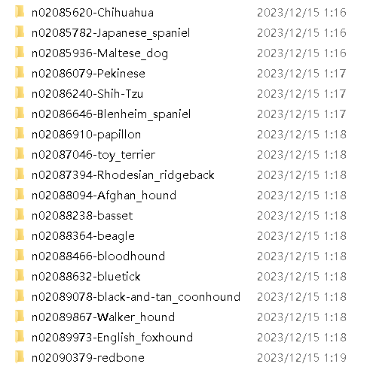
Data Augmentation
· Problem we have:
The dataset contains more than 20,000 images.
Processing the images one by one is impossible.
· How can we solve it?
We choose to use Image Batch Processor in MATLAB,
which can use the functions and process thousands
of images simultaneously.

Slide 5
Data Augmentation
Functions we decided to use:
· Gray
· Reduce the Contrast
· Flip
· Mirror
· Gaussian Noise
· Sharpen
Good News:
Most of them already have built-in functions in MATLAB.
They can easily be applied!

Slide 6
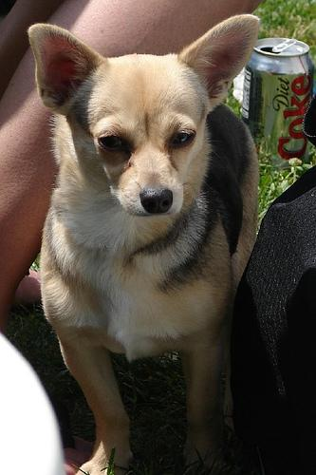
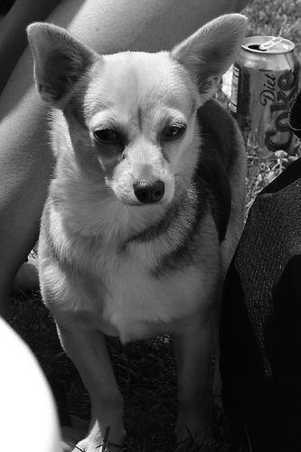
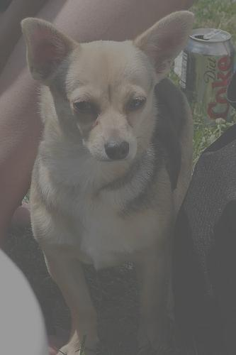
Data Augmentation
Original
Gray
Reduce the Contrast

Slide 7
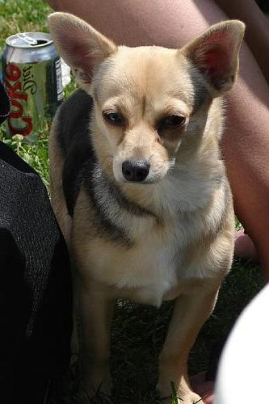
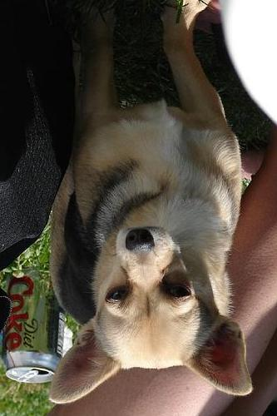
Data Augmentation
Original
Mirror
Flip

Slide 8
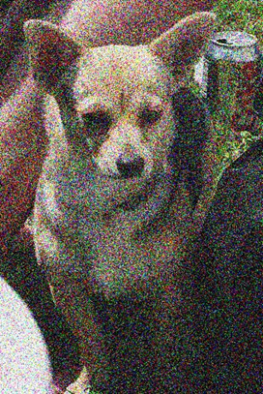

Data Augmentation
Original
Gaussian Noise
Sharpen

Slide 9
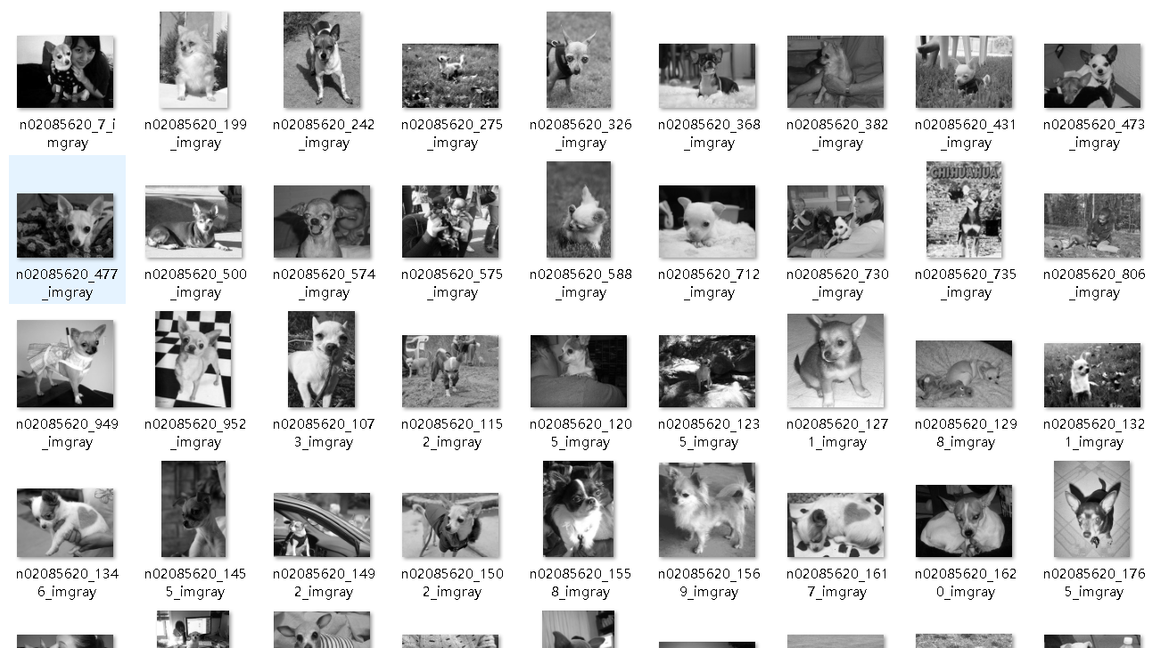
Data Augmentation
Example:
Gray function
· 20,000 images for more than 1 hour
· Takes a lot of time
But acceptable!

Slide 11
1 Agenda / Topic
6 Agenda / Topic
2 Agenda / Topic
7 Agenda / Topic
3 Agenda / Topic
8 Agenda / Topic
4 Agenda / Topic
9 Agenda / Topic
5 Agenda / Topic
10 Agenda / Topic

Slide 12
Project structure
Tech stacks
DATABASE
BACK-END
FRONT-END
HTML5
CSS3
MYSQL
JAVA
Swagger
Redis
JavaScript
Breed
SpringBoot
MyBatis
React
Record
Node
Prediction
Python
Umi
Tensorflow
Numpy
User
Ant Design
Matplotlib
Scikit-learn

Slide 13
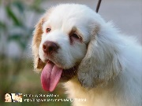
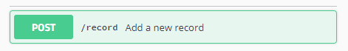

Project structure
Data flow
XML Database Query
Table.Record
Redis
MyBatis
ID & token
SpringBoot
Authentication Pass
Logical
Process
SpringBoot
Python
Client
HTTP Request
Web Server
Controller
Breed ID
SpringBoot
Mapper
Table.Prediction
Service
Prediction information
SpringBoot
Table.Breed
Breed Information

Slide 14
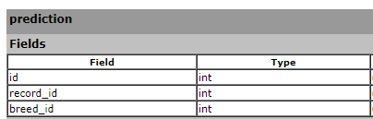
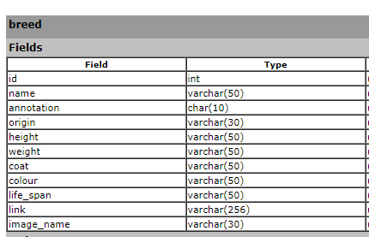
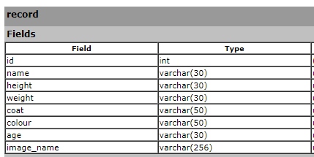
Project structure
database

Slide 15
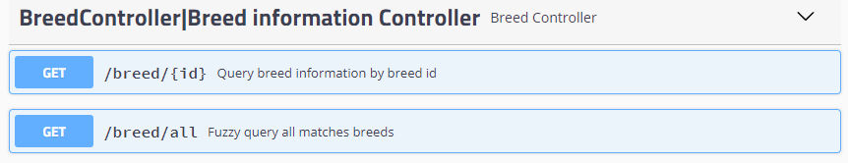
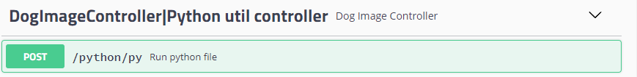
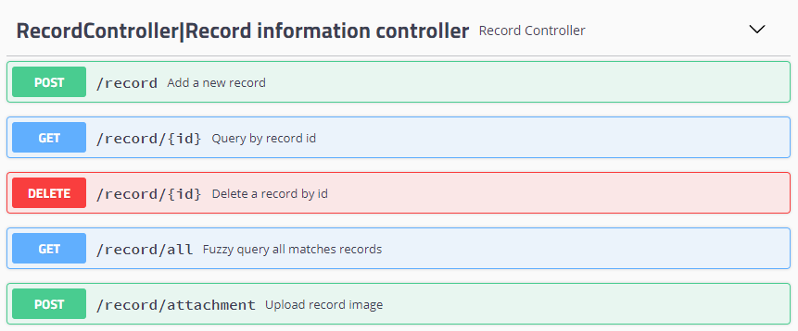
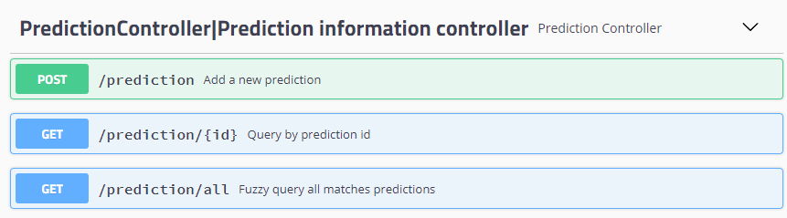
Project structure
BACKEND

Slide 16
Project structure
frontEND
TRY OUR DEMO !

